Slide 1
NEW OPTICAL MODALITY FOR PROSTATE CANCER VISUALIZATION
Besarion Partsvania¹, Tamaz Sulaberidze¹, Gia petriashvili¹, Alexandre Khuskivadze², Levan Shoshiashvili¹
1-Georgian Technical University, Institute of Cybernetics, Tbilisi, Georgia 0186.
2-Tbilisi State Medical University

Slide 2
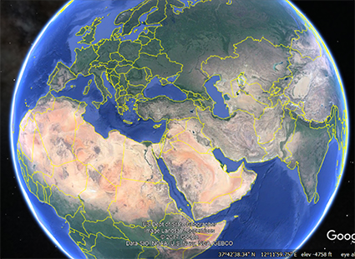
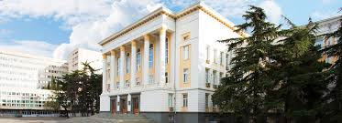
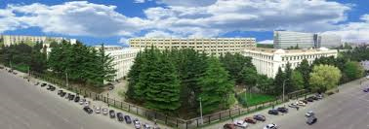

Slide 3

Despite tangible advances in prostate cancer diagnosis Prostate cancer is the second cause of cancer death in men worldwide [1]. This is so because existing methods of prostate cancer diagnosis are not able to detect it at early stage of development.
Just as with other cancers, timing and accuracy of diagnosis have major impacts on prostate cancer patient morbidity and quality of life.

Slide 4

Methods for prostate cancer diagnosis are:
Determination of Prostate-specific antigen (PSA) in the blood .
Digital rectal exam (DRE).
Biopsy
Prostate cancer antigen 3 (PCA3)
Imaging methods are:
Trans-rectal ultrasound (TRUS)
Magnetic resonance imaging (MRI)
Positron emission tomography (PET)
The difficulty of imaging methods remains in identifying small volumes of prostate cancer in the prostate gland

Slide 5
Efforts to utilize ultrasound for the detection of cancer have demonstrated poor specificity. As such, within the current standard of care, TRUS is used largely to guide biopsies rather than to identify the location and extent of cancer [2]
The use of MRI alone to detect prostate cancer has been evaluated in a limited fashion. On the other hand, MRI uses a powerful magnetic field and radiofrequency (RF) pulses. The strong magnetic field and RF pulses might be harmful. Besides, implanted medical devices may cause problems during an MRI exam.
PET - Three dimensional imaging is accomplished with the aid of computer tomography (CT) X –ray scan [4, 5]. However the X –ray scan contains some risk to be invasive.
The limitations of the imaging methods of prostate cancer detection motivated to seek of alternative techniques.

Slide 6
The use of near infrared (NIR) optical methods for diagnosing and detecting cancer has generated considerable interest. Advantage of optical methods are that they are non-invasive, fast, relatively inexpensive, pose no risk of ionizing radiation, and NIR light can easily penetrate thick tissues.
NIR transillumination technology widely was applied to the breast cancer diagnosis [8,9]. We think to apply this method to the prostate cancer. It is clear, that tansillumination imaging may actually work better for prostate than for breast, as the penetration depth between a infrared light source placed in the prostatic section of urethra and a camera placed in the rectum could be considerably shorter than that for a breast.
It worth to be appointed that NIR technology is not used as imaging tool for prostate cancer detection in vivo yet. So, firstly it is necessary to investigate the possibility of usage of IR radiation for cancer detection on isolated prostates.

Slide 7
The scheme providing the of experiment is following: firstly a patient is diagnosed with standard methods and if cancer is detected radical prostatectomy is performed. Immediately after this operation the prostate is examined in infrared light, the prostate infrared images are analyzed and location(s) of cancerous outgrowths are determined. After this prostate is investigated histomorphologically and histo pathological diagnosis is issued. Results of infrared examination are compared with histo pathological diagnosis.
It worth mentioning, that results of detection of cancerous outgrowth using IR method precisely coincides with detection of the cancerous outgrowth using histomorphological methods.

Slide 8
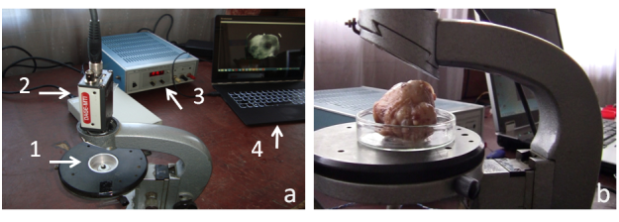
Here is shown experimental setup. In figure (a) by the arrows 1, 2, 3 and 4 are shown LED, CCD camera, power supply and computer, respectively. In the figure 1b is shown prostate placed on Petri dish between CCD camera and LED. Infrared light pass through prostate and is captured by CCD camera
CCD camera is connected with PC and we receive prostate infrared image. System is placed in darkness to avoid artifacts of visible light.

Slide 9
Emitted from LED infrared light pass through prostate and carries information about prostate tissue un-homogenity. Incident infrared light is converted into electrical signals by CCD camera and is transferred to PC. (like to human aye where incident visible light is converted into electrical impulses i.e. action potentials and are transferred to corresponding brain structures).

Slide 10
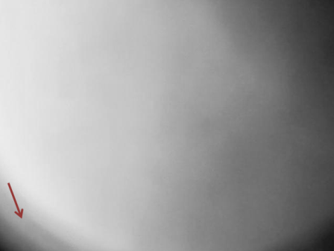
Here is sown Infrared image of the non-cancerous prostate as it is seen from the rectum side.
Radical prostatectomy was performed after the diagnosis of benign hyperplasia. It is easy noticeable that brightness is even almost everywhere. An inhomogeneity, shown by the arrow, belongs to the edge of Petri dish.

Slide 11
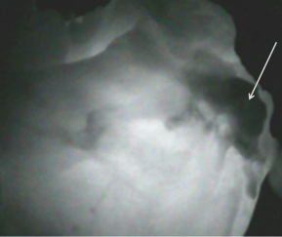
Infrared image of the cancerous prostate gland is characterized with extremely non homogeneity. Tis is so because cancerous tissue optical density is much higher that density of noncncerous tissue.
Here is shown one of cancerous prostates IR image. View from the rectum side. The dark area located in the upper right part of the picture (shown by arrow) corresponds to the cancerous outgrowth.
After the NIR investigation, this prostate gland was examined hysto-morphologically, following the standard method. In this case Gleason score was 8.

Slide 12
To compare the transillumination images of non-cancerous tissues with the cancerous ones, we have elaborated software (computer program). The principle is: program divides a brightness of the NIR transillumination image into 256 degrees. Consequently, the number 255 corresponds to the absolute white image. On the contrary, 0 corresponds to the absolute dark image. The software gives different codes to healthy and malignant areas. It separately calculates the average values of their brightness and calculates their ratio. Obtained data is stored in the memory. Such calculations are provided for all the next experiments so that, we can obtain the consequence of these ratios. When a number of experiments reach a statistically reliable value (at least 30 experiments), the program calculates a 95% confidence interval. In our case, after the examination of 41 cancerous prostates we obtained interval of the above mentioned ratios within 0.169417-0.239595 range.
Thereafter, if new unknown prostate NIR transillumination image will be analyzed, software will calculate above mentioned ratio of brightness. Finally, software will compare a meaning of this calculation with that confidence interval 0.169417-0.239595). If the newly measured number occurs in this 95% confidence interval, we can declare with 95% probability that this new prostate is cancerous.

Slide 13
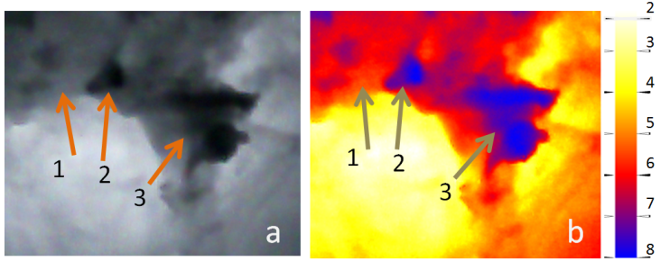
Besides, a developed software enables to map out the distribution of prostate cancer with different aggressiveness, in the color expression. Here is demonstrated a part of the prostate gland in grayscale (a), and in color (b) representation. As shown in the grayscale picture, the cancerous outgrowth with highest aggressiveness are the darkest areas indicated by the arrows 2 and 3. Less aggressiveness corresponds to the area indicated by the arrow 1. On the colored part of the picture, the cancer with highest aggressiveness are shown in blue (arrows 2 and 3), while with the less aggressiveness are shown in red (arrow 1). Right hand side of the picture represents the color bar.

Slide 14
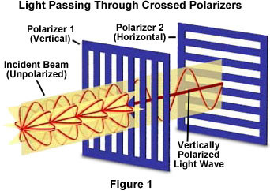
Every other form of natural or artificial illumination transmits light waves whose electric field vectors vibrate in all perpendicular planes with respect to the direction of propagation. When the electric field vectors are restricted to a single plane by filtration, then the light is said to be polarized with respect to the direction of propagation and all waves vibrate in the same plane.Polarizer 1 and 2 (or polarizer and analyzer) represent filters. Orientation of the analizer determines passing of polarized light though it. In the case shown here polarized beam will not pas through analyzer. If analizer is oriented parallel to polarizer, polarized light will pass through it.

Slide 15
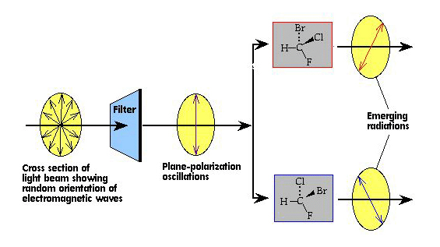
If optical isomers are placed on the path of the polarized beam, the E vector polarization angle can be shifted. Consequently, corresponding rotation of polarizer 2 causes passing of the light through it . Thus, placement of optical isomers on the way of incidence plane polarized beam causes turn of E vector direction.

Slide 16
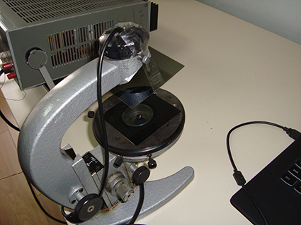
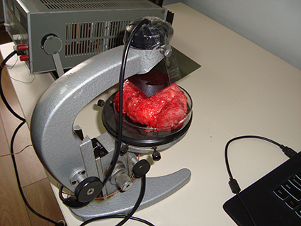
Prostate tissue behaves like isomers and causes turn of E vectors. The experimental setup for polarized IR light is shown in this slide. Arrows indicate polarizer films.

Slide 17
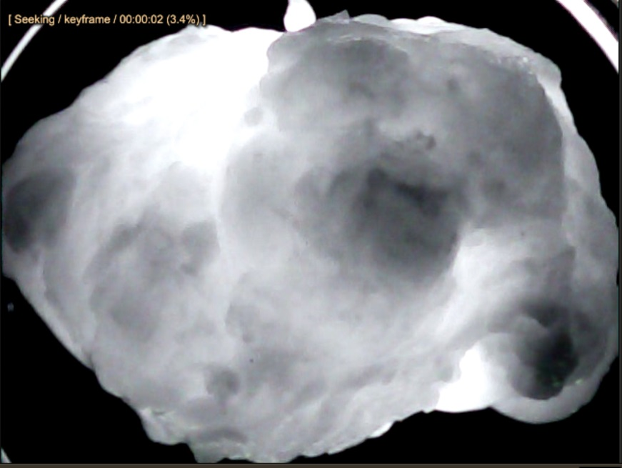
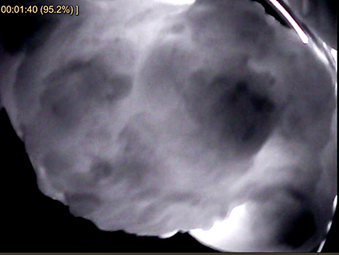
Left figure represents IR image of cancerous prostate obtained in non polarized light. On the right figure is shown image of the same prostate in polarized IR light. It is easy noticeable that polarized light gives opportunity to detect much more details and additional cancerous outgrowths which were not detected in no polarized light.

Slide 18
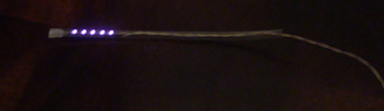
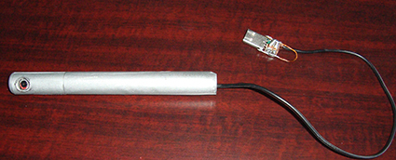
On the basis of our investigations we have developed and fabricated prototype of future device for prostate cancer diagnosis in vivo. Device consists from IR illuminator, which will be placed in the prostate through urethral channel and from the IR detector, which will be placed in the rectum. Detector is connected to PC. Elaborated software forms prostate infrared images and determines existence of cancer with 95% probability.

Slide 19
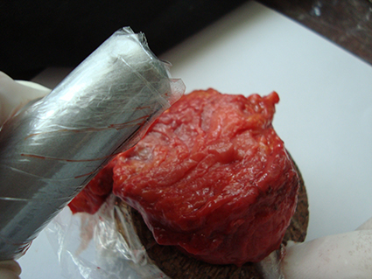
Here is shown detector with isolated prostate.

Slide 20
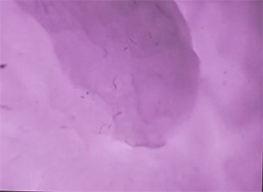
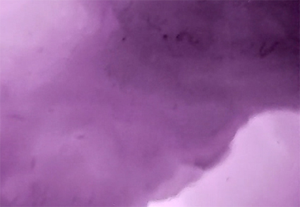
Here we see cancerous outgrowths detected by our device. Cancerous areas are shown with arrows.

Slide 21
Finally, in our opinion the method is promising and we intend to continue our investigations.
Thank you for attention.

Slide 22
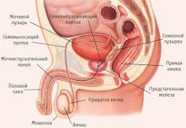

Slide 23
1. http://www.who.int/mediacentre/factsheets/fs297/en/
2. . H. Watanabe, D. Igari, Y. Tanahashi, et al. Transrectal ultrasonotomography of the prostate. J Urol.;114:734 (1975).
3. F.V. Coakley, A Qayyum, J. Kurhanewicz. Magnetic resonance imaging and spectroscopic imaging of prostate cancer. J .Urol. 170: S69–S75. discussion S75–S76. (2003)
4. N. Oyama, H. Akino, H. Kanamaru, Y. Suzuki, S. Muramoto, Y. Yonekura, N. Sadato, K. Yamamoto, K. Okada.¹¹C-Acetate PET Imaging of Prostate Cancer. The Journal of Nuclear Medicine 43(2): 181-186, (2002).
5. P. E. Valk, D.L. Bailey, D.W. Townsend, M. N. Maisey. Positron Emission Tomography: Basic Science and Clinical Practice. New York: Springer-Verlag; 884 pages. (2004).
6. . X. Wang , S.S. Huang , W.D. Heston , H. Guo, B.C. Wang, J.P. Basilion. Development of targeted near-infrared imaging agents for prostate cancer. Mol Cancer Ther. 13 (11), 2595-606 (2014)
7.B. Zhu , G. Wu , H. Robinson , N. Wilganowski , M.A. Hall , S.C. Ghosh , K.L. Pinkston , A. Azhdarinia, B.R. Harvey , E.M. Sevick-Muraca . Tumor margin detection using quantitative NIRF molecular imaging targeting EpCAM validated by far red gene reporter iRFP. Mol Imaging Biol. 15 (5),560-568 (2013
8.J. L. Champaign, G.J. Cederbom, Advances in Breast Cancer Detection with Screening Mammography Ochsner J. 2(1): 33–35 (2000)
9.B.J. Tromberg, A. Cerussi, N.Shah, M. Compton, A. Durkin, D. Hsiang, J. Butler, R.Mehta, Imaging in breast cancer: Diffuse optics in breast cancer: detecting tumors in pre-menopausal women and monitoring neoadjuvant chemotherapy. Breast Cancer Research 7 (6) 279 -285, 2005
10.A. Khuskivadze, D. Kochiashvili, B. Partsvania, “Near Infrared Radiation in Diagnosis of Prostate Cancer: Preliminary Results” Urology 82(3): S1-S334. (2013).
11. A. Khuskivadze, B. Partsvania, D. Kochiashvili, “Visualization of Human Prostate Cancer Using Infrared Radiation”. Urology 84(3): S 304, (2014).

